Slide 1




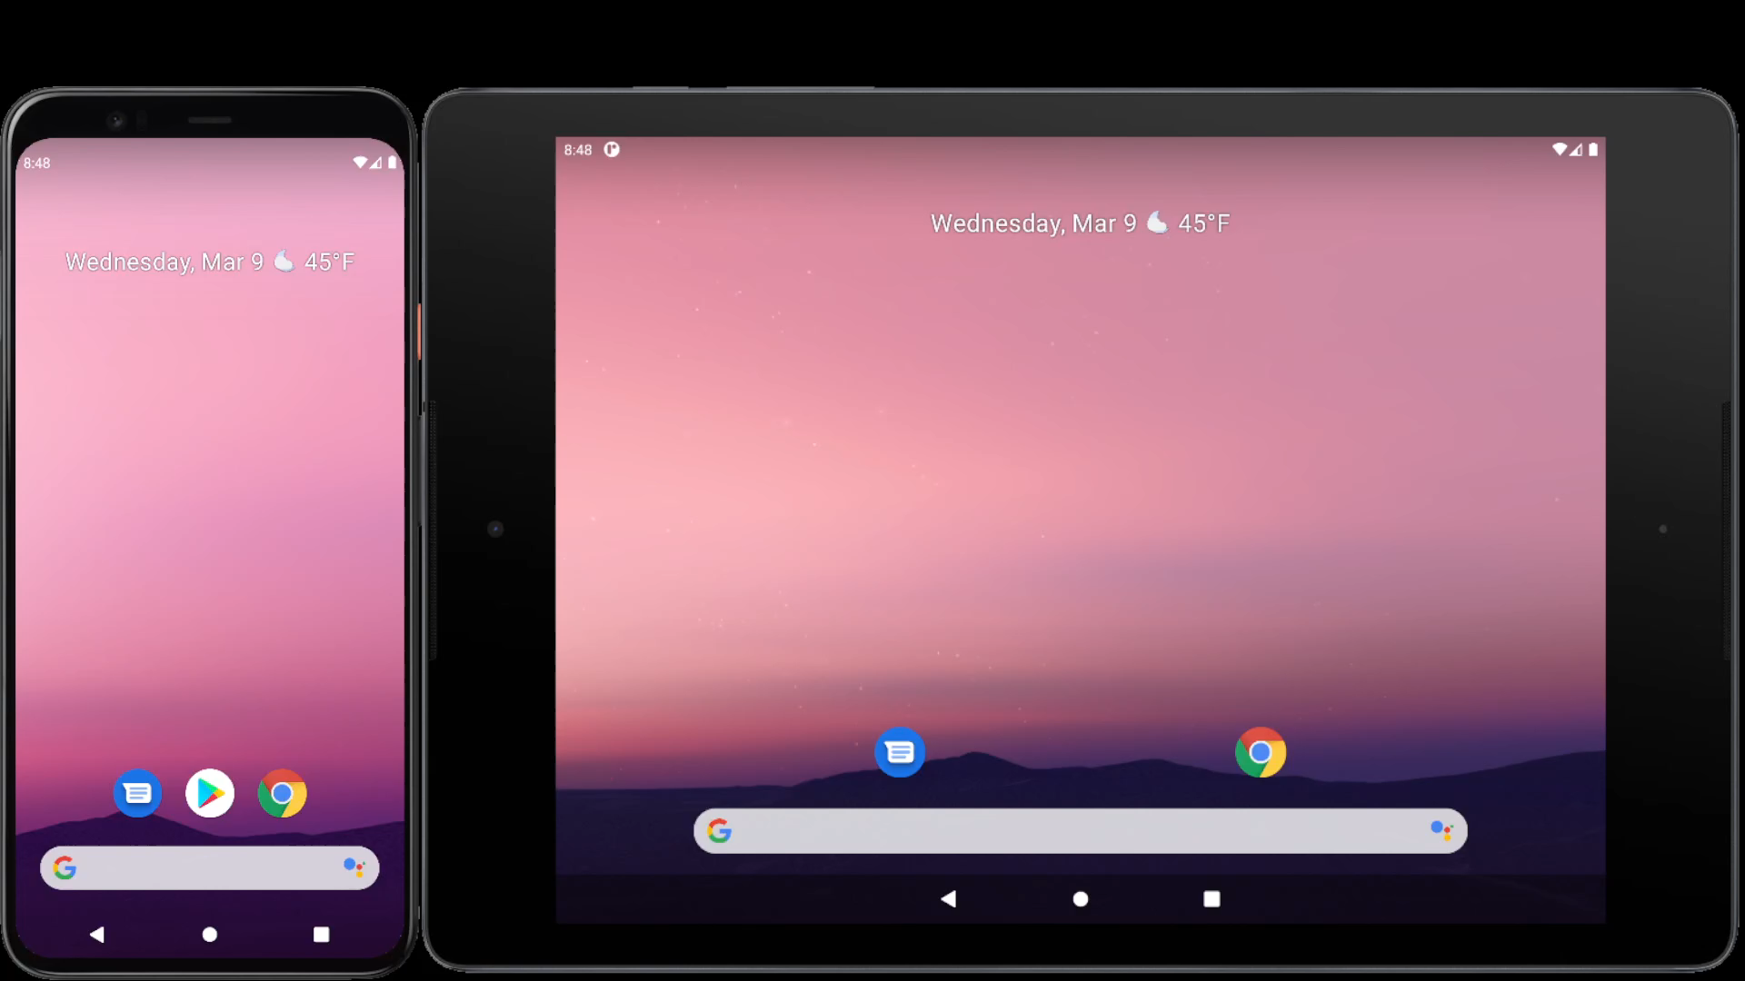
DoorSine™
Digital Assistant for Staff Office Door
Knut Sander Lien Blakkestad
With
Doctor Shoaib Jameel

